Slide 1
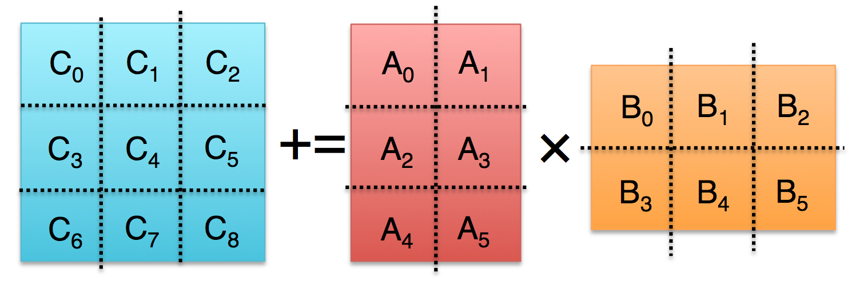
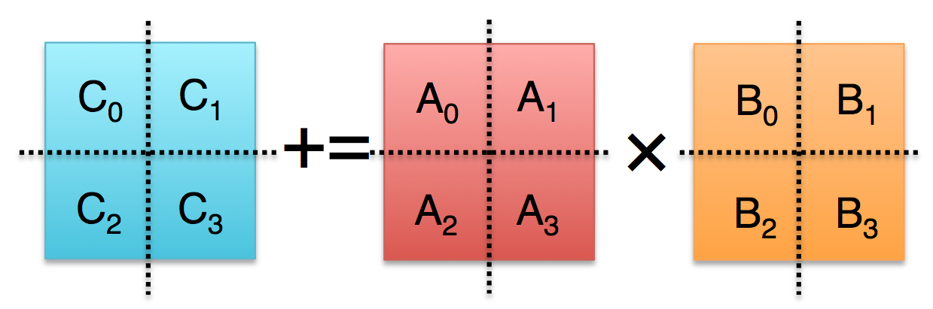

Practical Fast Matrix Multiplication Algorithms
Jianyu Huang
Committee members: Prof. Robert van de Geijn (Advisor),
Prof. Don Batory, Prof. George Biros, Prof. Keshav Pingali, and Dr. Greg Henry
August 22, 2017
UTCS PhD Dissertation Proposal
GDC 5.816, Austin, TX

Slide 2
Outline
Motivation
Background
Practical Strassen’s Algorithm (SC16)
Practical Fast Matrix Multiplication (IPDPS17)
Proposed Work
Conclusion

Slide 3
Outline
Motivation
Background
Practical Strassen’s Algorithm (SC16)
Practical Fast Matrix Multiplication (IPDPS17)
Proposed Work
Conclusion

Slide 4

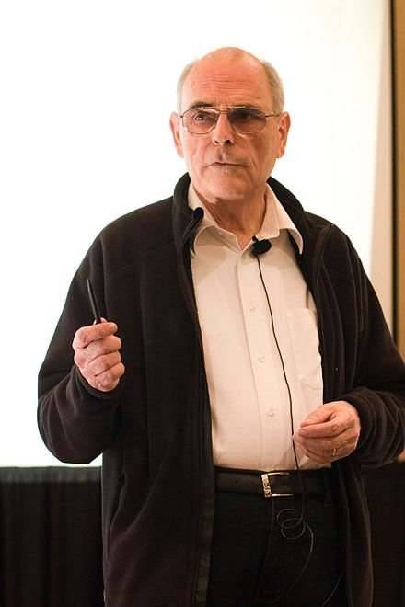
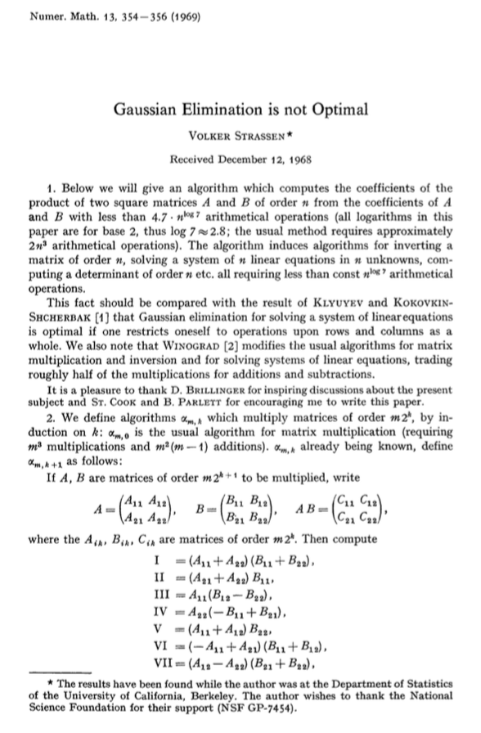
* Background Image: Mount Everest. From https://www.adventurealternative.com
STRASSEN, the first Fast Matrix Multiplication (FMM)…
Volker Strassen
(Born in 1936, aged 81)
Original Strassen Paper (1969)

Slide 5
50 Years of History of Fast Matrix Multiplication (in theory)
FMM: Matrix multiplication algorithms with asymptotic complexity < O(n³)
3
Naive
2.7951
[Pan78]
2.8074
[Strassen69]
2.7799
[BCRL79]
2.4966
[CW82]
2.522
[Schonhage81]
2.3728642
[Williams12]
2.4785
[Strassen86]
2.374
[Stothers10]
2.3728639
[LG14]
2.376
[CW87]
Exponent ω for the arithmetic complexity of fast matrix multiplication O(O^{ω})
Jean-Guillaume Dumas, and Victor Pan. "Fast matrix multiplication and symbolic computation." arXiv preprint arXiv:1612.05766 (2016).

Slide 6
40 Years of FMM implementations (in practice)
Layering FMM upon standard GEMM calls
IBM ESSL, Huss-Lederman et al’96, Douglas et al’94
Lower level implementation
D’Alberto & Nicolau’09
Sequential
Pan’78, Bailey’88, Laderman et al’92, Douglas et al’94, Huss-Lederman et al’96
Parallelization for shared memory
Kumar et al’95, D’Alberto & Nicolau’09, D’Alberto et al’11, Benson & Ballard’15
Parallelization for distributed memory
Luo & Drake’95, Grayson & van de Geijn’96, Lipshitz et al’12
Parallelization for GPUs
Li at el’11, Lai et al’13

Slide 7
Motivations

Slide 8
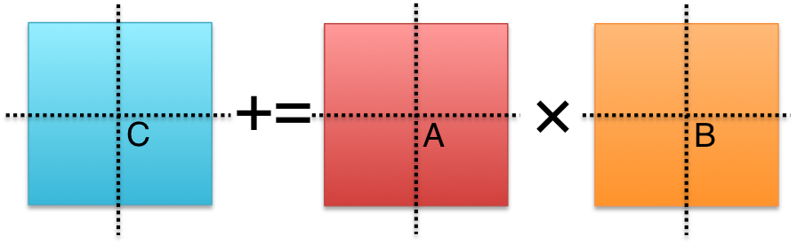



Problems with conventional FMM implementations
Conventional Implementations
Matrix Size
Must be large
Matrix Shape
Must be square
Memory movement
No Additional
Workspace
Padding
Buffers
Parallelism
Usually task parallelism

Slide 9
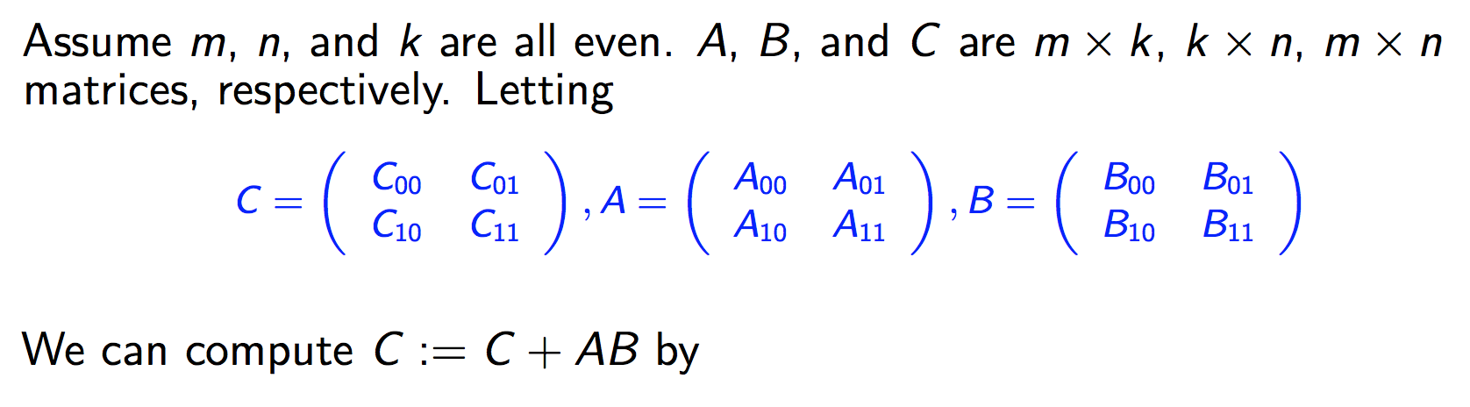
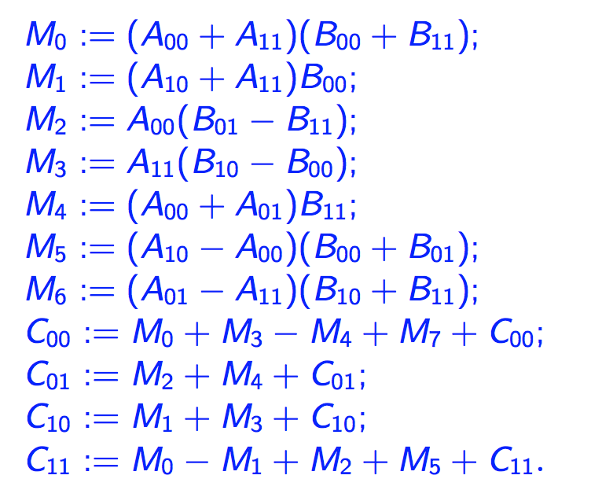
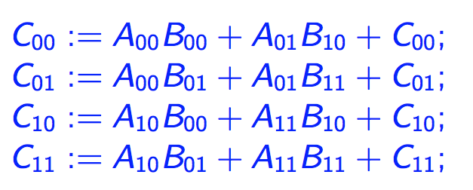
One-level Strassen’s Algorithm (In theory)
Direct Computation
Strassen’s Algorithm
8 multiplications, 8 additions
7 multiplications, 22 additions
*Strassen, Volker. "Gaussian elimination is not optimal." Numerische Mathematik 13, no. 4 (1969): 354-356.

Slide 10
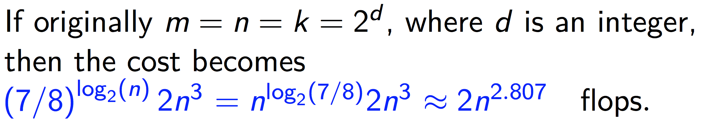
Multi-level Strassen’s Algorithm (In theory)
M₀ := (A₀₀+A₁₁)(B₀₀+B₁₁);
M₁ := (A₁₀+A₁₁)B₀₀;
M₂ := A₀₀(B₀₁–B₁₁);
M₃ := A₁₁(B₁₀–B₀₀);
M₄ := (A₀₀+A₀₁)B₁₁;
M₅ := (A₁₀–A₀₀)(B₀₀+B₀₁);
M₆ := (A₀₁–A₁₁)(B₁₀+B₁₁);
C₀₀ += M₀ + M₃ – M₄ + M₆
C₀₁ += M₂ + M₄
C₁₀ += M₁ + M₃
C₁₁ += M₀ – M₁ + M₂ + M₅
One-level Strassen (1.14x speedup)
8 multiplications → 7 multiplications ;
Two-level Strassen (1.30x speedup)
64 multiplications → 49 multiplications;
d-level Strassen (n³/n^{2.803} speedup)
8^{d} multiplications → 7^{d} multiplications;

Slide 11
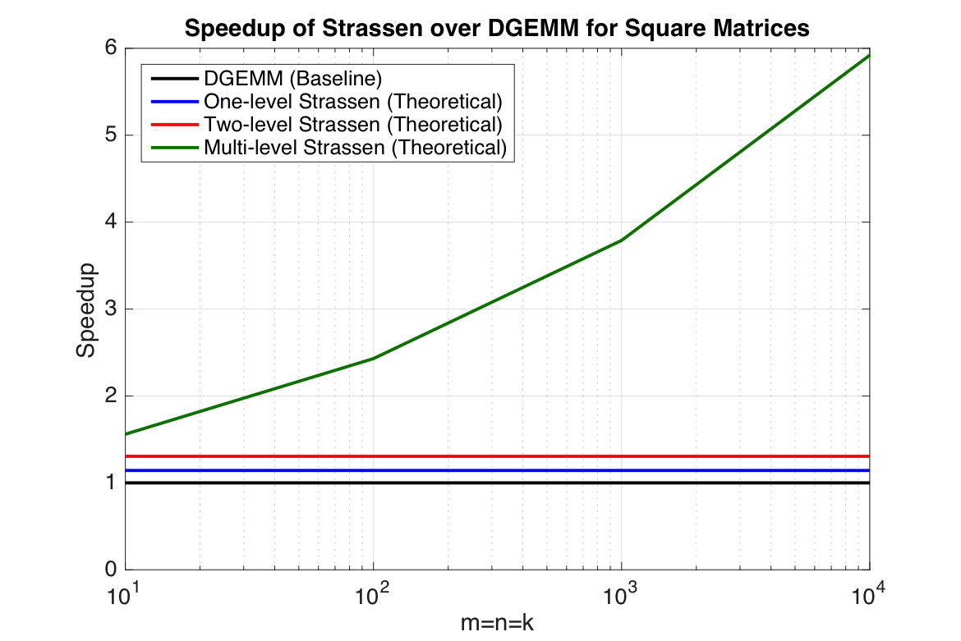
Multi-level Strassen’s Algorithm (In theory)
M₀ := (A₀₀+A₁₁)(B₀₀+B₁₁);
M₁ := (A₁₀+A₁₁)B₀₀;
M₂ := A₀₀(B₀₁–B₁₁);
M₃ := A₁₁(B₁₀–B₀₀);
M₄ := (A₀₀+A₀₁)B₁₁;
M₅ := (A₁₀–A₀₀)(B₀₀+B₀₁);
M₆ := (A₀₁–A₁₁)(B₁₀+B₁₁);
C₀₀ += M₀ + M₃ – M₄ + M₆
C₀₁ += M₂ + M₄
C₁₀ += M₁ + M₃
C₁₁ += M₀ – M₁ + M₂ + M₅
One-level Strassen (1.14x speedup)
8 multiplications → 7 multiplications ;
Two-level Strassen (1.30x speedup)
64 multiplications → 49 multiplications;
d-level Strassen (n³/n^{2.803} speedup)
8^{d} multiplications → 7^{d} multiplications;

Slide 12
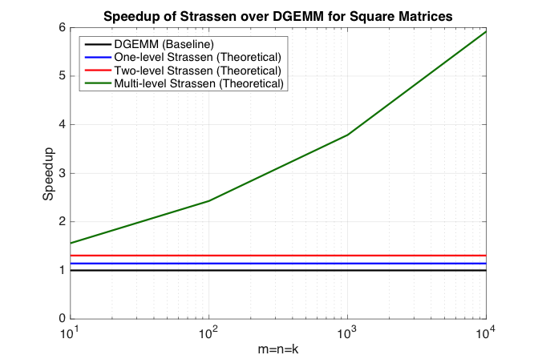
Strassen’s Algorithm (In practice)
M₀ := (A₀₀+A₁₁)(B₀₀+B₁₁);
M₁ := (A₁₀+A₁₁)B₀₀;
M₂ := A₀₀(B₀₁–B₁₁);
M₃ := A₁₁(B₁₀–B₀₀);
M₄ := (A₀₀+A₀₁)B₁₁;
M₅ := (A₁₀–A₀₀)(B₀₀+B₀₁);
M₆ := (A₀₁–A₁₁)(B₁₀+B₁₁);
C₀₀ += M₀ + M₃ – M₄ + M₆
C₀₁ += M₂ + M₄
C₁₀ += M₁ + M₃
C₁₁ += M₀ – M₁ + M₂ + M₅

Slide 13
Strassen’s Algorithm (In practice)
T₀
T₁
M₀ := (A₀₀+A₁₁)(B₀₀+B₁₁);
M₁ := (A₁₀+A₁₁)B₀₀;
M₂ := A₀₀(B₀₁–B₁₁);
M₃ := A₁₁(B₁₀–B₀₀);
M₄ := (A₀₀+A₀₁)B₁₁;
M₅ := (A₁₀–A₀₀)(B₀₀+B₀₁);
M₆ := (A₀₁–A₁₁)(B₁₀+B₁₁);
C₀₀ += M₀ + M₃ – M₄ + M₆
C₀₁ += M₂ + M₄
C₁₀ += M₁ + M₃
C₁₁ += M₀ – M₁ + M₂ + M₅
T₂
One-level Strassen (1.14x speedup)
7 multiplications + 22 additions;
Two-level Strassen (1.30x speedup)
49 multiplications + 334 additions;
d-level Strassen (n³/n^{2.803} speedup)
Numerical unstable; Not achievable
T₃
T₄
T₅
T₆
T₇
T₈
T₉

Slide 14
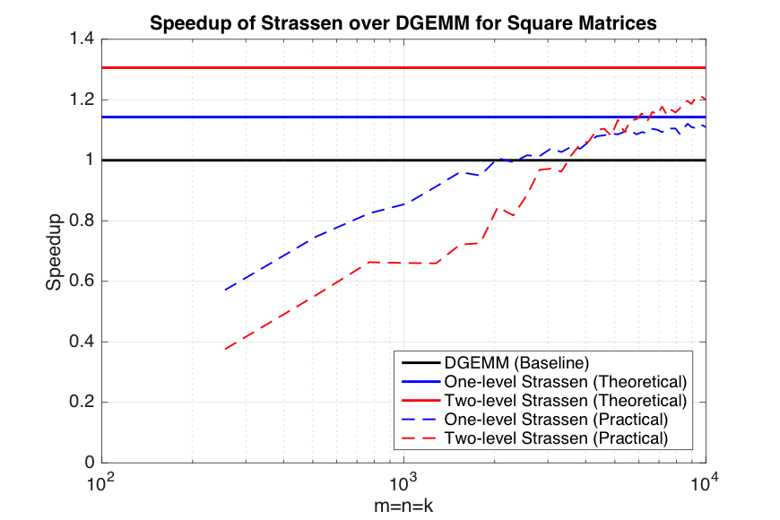

Strassen’s Algorithm (In practice)
T₀
T₁
M₀ := (A₀₀+A₁₁)(B₀₀+B₁₁);
M₁ := (A₁₀+A₁₁)B₀₀;
M₂ := A₀₀(B₀₁–B₁₁);
M₃ := A₁₁(B₁₀–B₀₀);
M₄ := (A₀₀+A₀₁)B₁₁;
M₅ := (A₁₀–A₀₀)(B₀₀+B₀₁);
M₆ := (A₀₁–A₁₁)(B₁₀+B₁₁);
C₀₀ += M₀ + M₃ – M₄ + M₆
C₀₁ += M₂ + M₄
C₁₀ += M₁ + M₃
C₁₁ += M₀ – M₁ + M₂ + M₅
T₂
One-level Strassen (1.14x speedup)
7 multiplications + 22 additions;
Two-level Strassen (1.30x speedup)
49 multiplications + 334 additions;
d-level Strassen (n³/n^{2.803} speedup)
Numerical unstable; Not achievable
T₃
T₄
T₅
T₆
T₇
T₈
T₉

Slide 15
To achieve practical high performance
of Strassen/FMM algorithms…...
Conventional Implementations
Our Solutions
Matrix Size
Must be large
Matrix Shape
Must be square
Memory movement
No Additional
Workspace
Padding
Buffers
Parallelism

Slide 16
To achieve practical high performance
of Strassen/FMM algorithms…...
Conventional Implementations
Our Solutions
Matrix Size
Must be large
Matrix Shape
Must be square
Memory movement
No Additional
Workspace
Padding
Buffers
Parallelism
Usually task parallelism

Slide 17
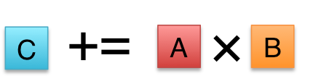

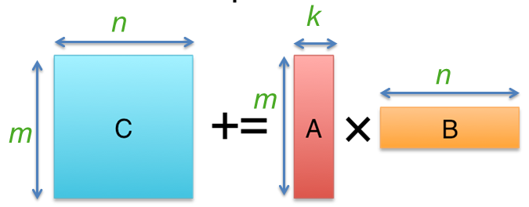
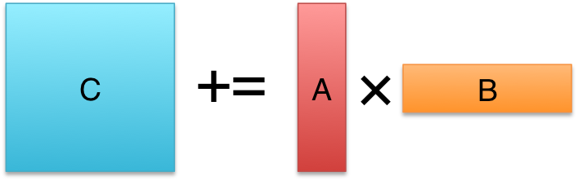

To achieve practical high performance
of Strassen/FMM algorithms…...
Conventional Implementations
Our Solutions
Matrix Size
Must be large
Matrix Shape
Must be square
Memory movement
No Additional
Workspace
Padding
Buffers
Parallelism
Usually task parallelism
Can be data parallelism

Slide 18
Proposed Work
Practical high-performance Strassen.
Utilize a performance model to predict the relative performance
Practical fast matrix multiplication algorithms.
Leverage a code generator to generate ~200 implementations
Acceleration of tensor contractions via Strassen.
First paper to apply Strassen’s algorithm for tensor contraction.
Exploration of Strassen/FMM for distributed memory.
Fusion with machine learning applications.
Pedagogical outreach for Strassen.
Jianyu Huang, Tyler Smith, Greg Henry, and Robert van de Geijn. “Strassen’s Algorithm Reloaded.” In SC’16.
Jianyu Huang, Leslie Rice, Devin A. Matthews, Robert A. van de Geijn. “Generating Families of Practical Fast Matrix Multiplication Algorithms.” In IPDPS17
Jianyu Huang, Devin A. Matthews, and Robert A. van de Geijn. “Strassen’s Algorithm for Tensor Contraction.” arXiv:1704.03092 (2017). In Submission.
Jianyu Huang, Robert A. van de Geijn. “BLISlab: A Sandbox for Optimizing GEMM.” FLAME Working Note #80, The University of Texas at Austin, Department of Computer Science. Technical Report TR-16-13. August 31, 2016.

Slide 19
Outline
Motivation
Background
Practical Strassen’s Algorithm (SC16)
Practical Fast Matrix Multiplication (IPDPS17)
Proposed Work
Conclusion

Slide 20
High-performance matrix multiplication (GEMM)

Slide 21
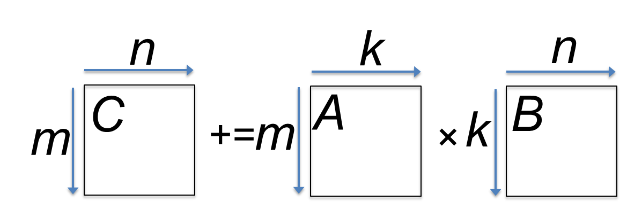
State-of-the-art GEMM in BLIS
BLAS-like Library Instantiation Software (BLIS) is a portable framework for instantiating BLAS-like dense linear algebra libraries.
BLIS provides a refactoring of GotoBLAS algorithm (best-known approach on CPU) to implement GEMM.
GEMM implementation in BLIS has 6-layers of loops. The outer 5 loops are written in C. The inner-most loop (micro-kernel) is written in assembly for high performance.
Field Van Zee, and Robert van de Geijn. “BLIS: A Framework for Rapidly Instantiating BLAS Functionality.” ACM TOMS 41.3 (2015): 14.
Kazushige Goto, and Robert van de Geijn. “High-performance implementation of the level-3 BLAS.” ACM TOMS 35.1 (2008): 4.
Kazushige Goto, and Robert van de Geijn. “Anatomy of high-performance matrix multiplication.” ACM TOMS 34.3 (2008): 12.

Slide 22
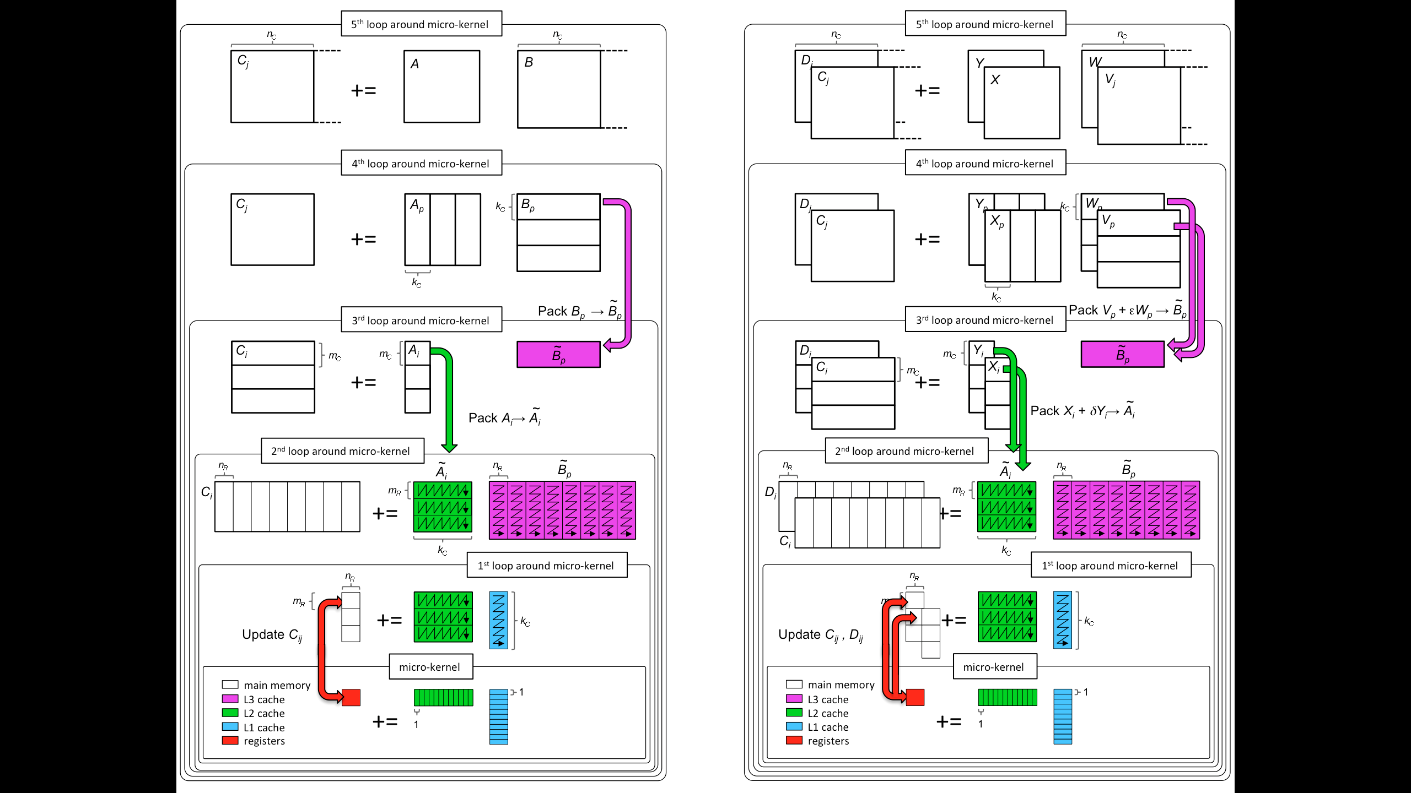
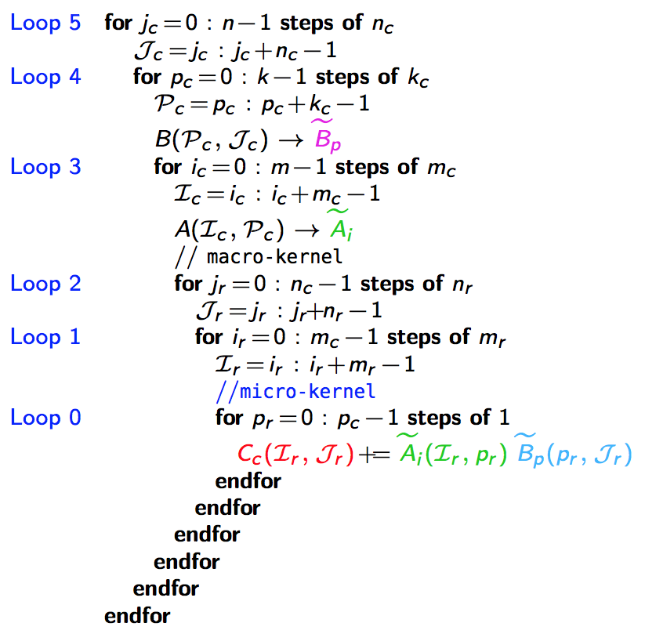
GotoBLAS algorithm for GEMM in BLIS
k_{C} x n_{C}
L3 Cache
m_{C} x k_{C}
L2 Cache
m_{R} x n_{R}
*Field G. Van Zee, and Tyler M. Smith. “Implementing high-performance complex matrix multiplication via the 3m and 4m methods.” In ACM Transactions on Mathematical Software (TOMS), accepted.
Register
m_{R} x k_{C}
k_{C} x n_{R}

Slide 23
Outline
Motivation
Background
Practical Strassen’s Algorithm (SC16)
Practical Fast Matrix Multiplication (IPDPS17)
Proposed Work
Conclusion

Slide 24
Practical Strassen’s Algorithm
*Jianyu Huang, Tyler Smith, Greg Henry, and Robert van de Geijn. “Strassen’s Algorithm Reloaded.” In SC’16.

Slide 25
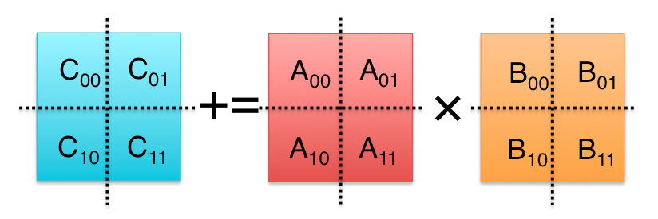
Strassen’s Algorithm Reloaded
M₀ := (A₀₀+A₁₁)(B₀₀+B₁₁);
M₁ := (A₁₀+A₁₁)B₀₀;
M₂ := A₀₀(B₀₁–B₁₁);
M₃ := A₁₁(B₁₀–B₀₀);
M₄ := (A₀₀+A₀₁)B₁₁;
M₅ := (A₁₀–A₀₀)(B₀₀+B₀₁);
M₆ := (A₀₁–A₁₁)(B₁₀+B₁₁);
C₀₀ += M₀ + M₃ – M₄ + M₆
C₀₁ += M₂ + M₄
C₁₀ += M₁ + M₃
C₁₁ += M₀ – M₁ + M₂ + M₅
M₀ := (A₀₀+A₁₁)(B₀₀+B₁₁); C₀₀ += M₀; C₁₁ += M₀;
M₁ := (A₁₀+A₁₁)B₀₀; C₁₀ += M₁; C₁₁ –= M₁;
M₂ := A₀₀(B₀₁–B₁₁); C₀₁ += M₂; C₁₁ += M₂;
M₃ := A₁₁(B₁₀–B₀₀); C₀₀ += M₃; C₁₀ += M₃;
M₄ := (A₀₀+A₀₁)B₁₁; C₀₁ += M₄; C₀₀ –= M₄;
M₅ := (A₁₀–A₀₀)(B₀₀+B₀₁); C₁₁ += M₅;
M₆ := (A₀₁–A₁₁)(B₁₀+B₁₁); C₀₀ += M₆;
M := (X+Y)(V+W); C +=M; D +=M;
M := (X+δY)(V+εW); C += γ₀M; D += γ₁M;
γ₀, γ₁,δ,ε ∈ {-1, 0, 1}.
General operation for one-level Strassen:

Slide 26
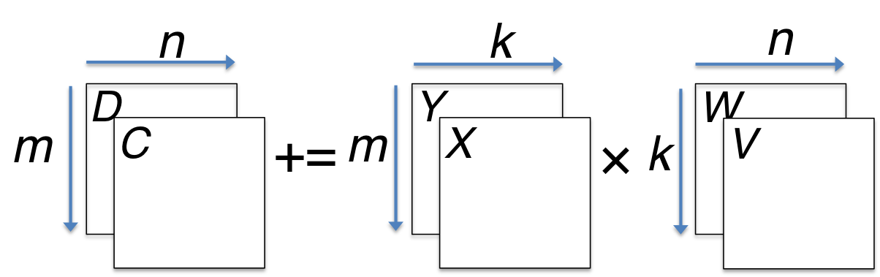
M := (X+δY)(V+εW); C += γ₀M; D += γ₁M;
γ₀, γ₁,δ,ε ∈ {-1, 0, 1}.
M := (X+Y)(V+W); C += M; D += M;

Slide 27
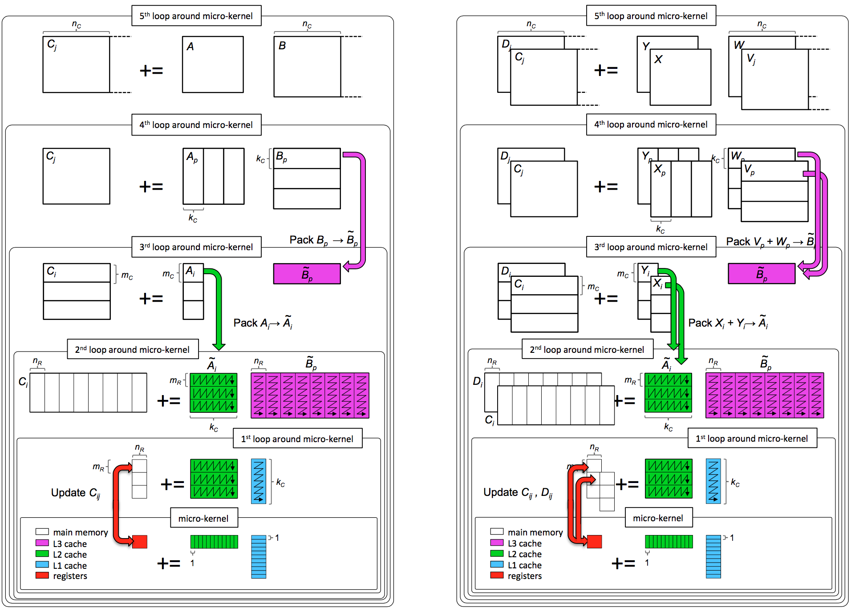
M := (X+δY)(V+εW); C += γ₀M; D += γ₁M;
γ₀, γ₁,δ,ε ∈ {-1, 0, 1}.
C += AB;
M := (X+Y)(V+W); C += M; D += M;

Slide 28
M := (X+δY)(V+εW); C += γ₀M; D += γ₁M;
γ₀, γ₁,δ,ε ∈ {-1, 0, 1}.
C += AB;
M := (X+Y)(V+W); C += M; D += M;
k_{C} x n_{C}
L3 Cache
m_{C} x k_{C}
L2 Cache
m_{R} x n_{R}
Register

Slide 29
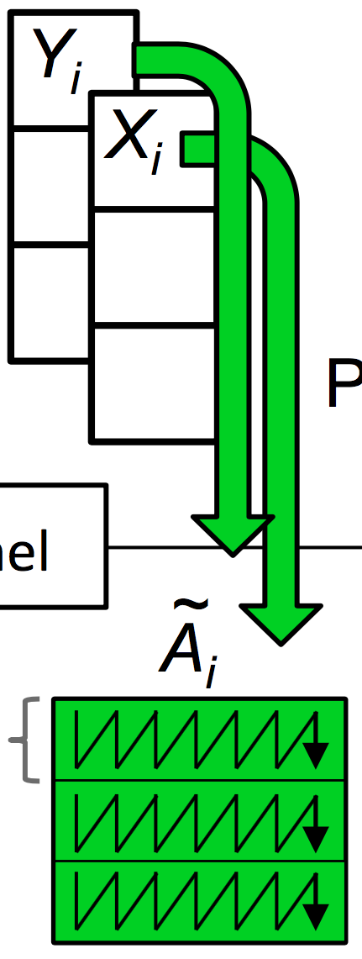
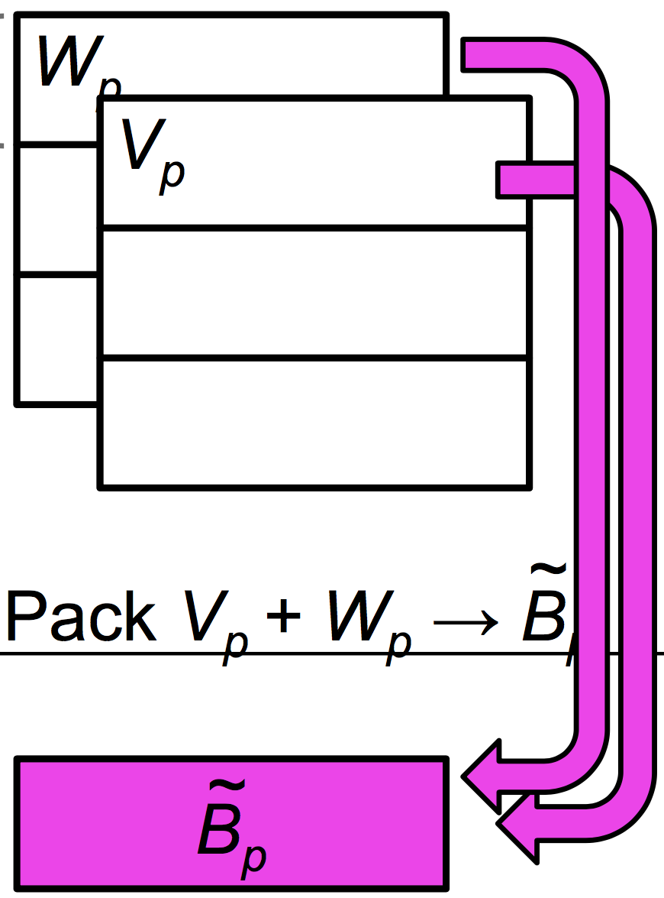
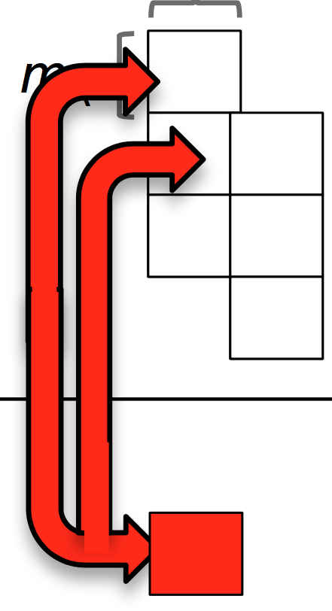

Slide 30
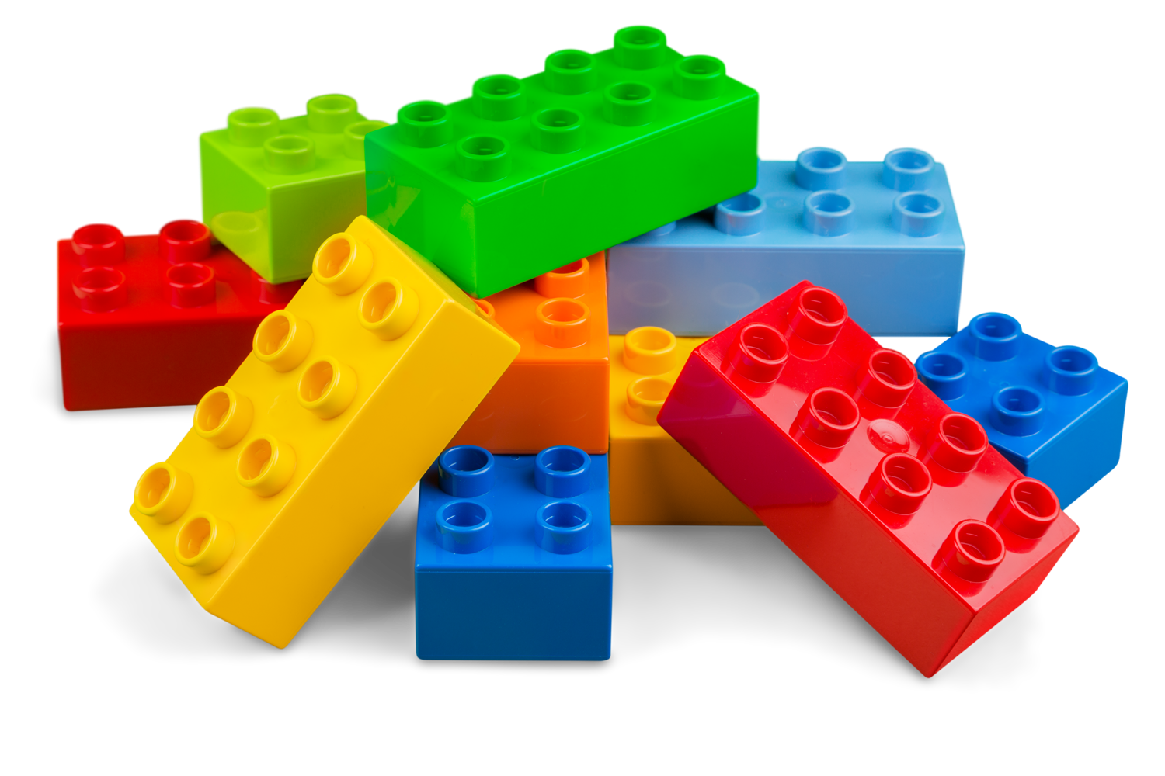
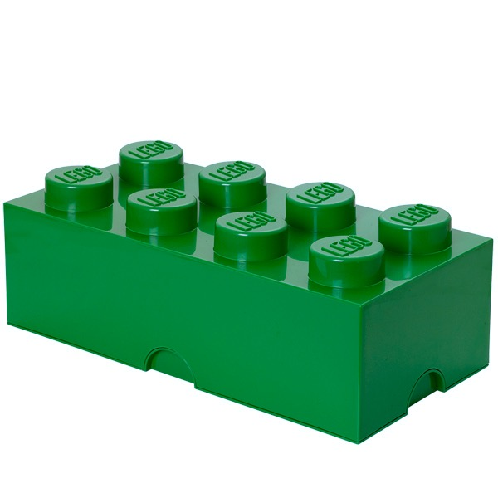
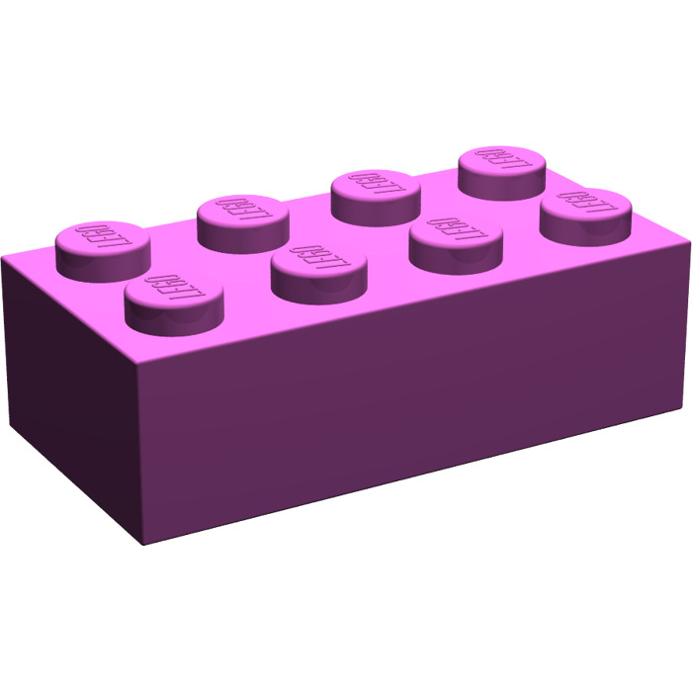
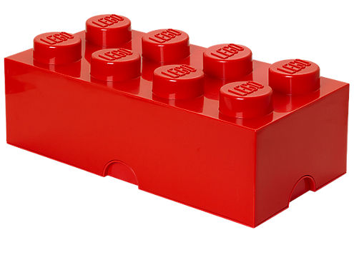
Variations on a theme
✘
✘
✘
Naïve Strassen
AB Strassen
ABC Strassen
✔
✔
✘
✔
✔
✔

Slide 31
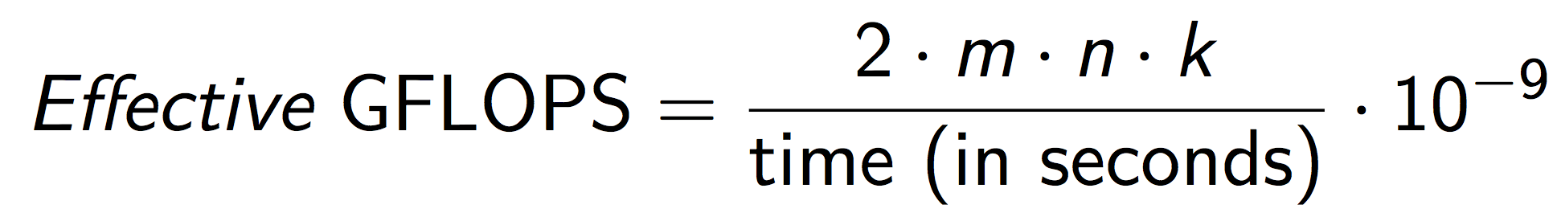
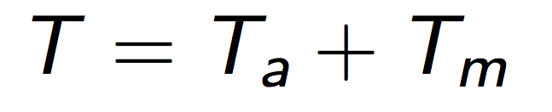
Performance Model
Performance Metric
Total Time Breakdown
Arithmetic
Operations
Memory
Operations

Slide 32
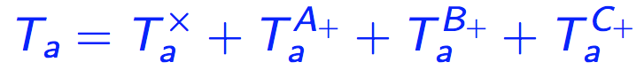
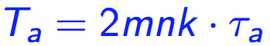
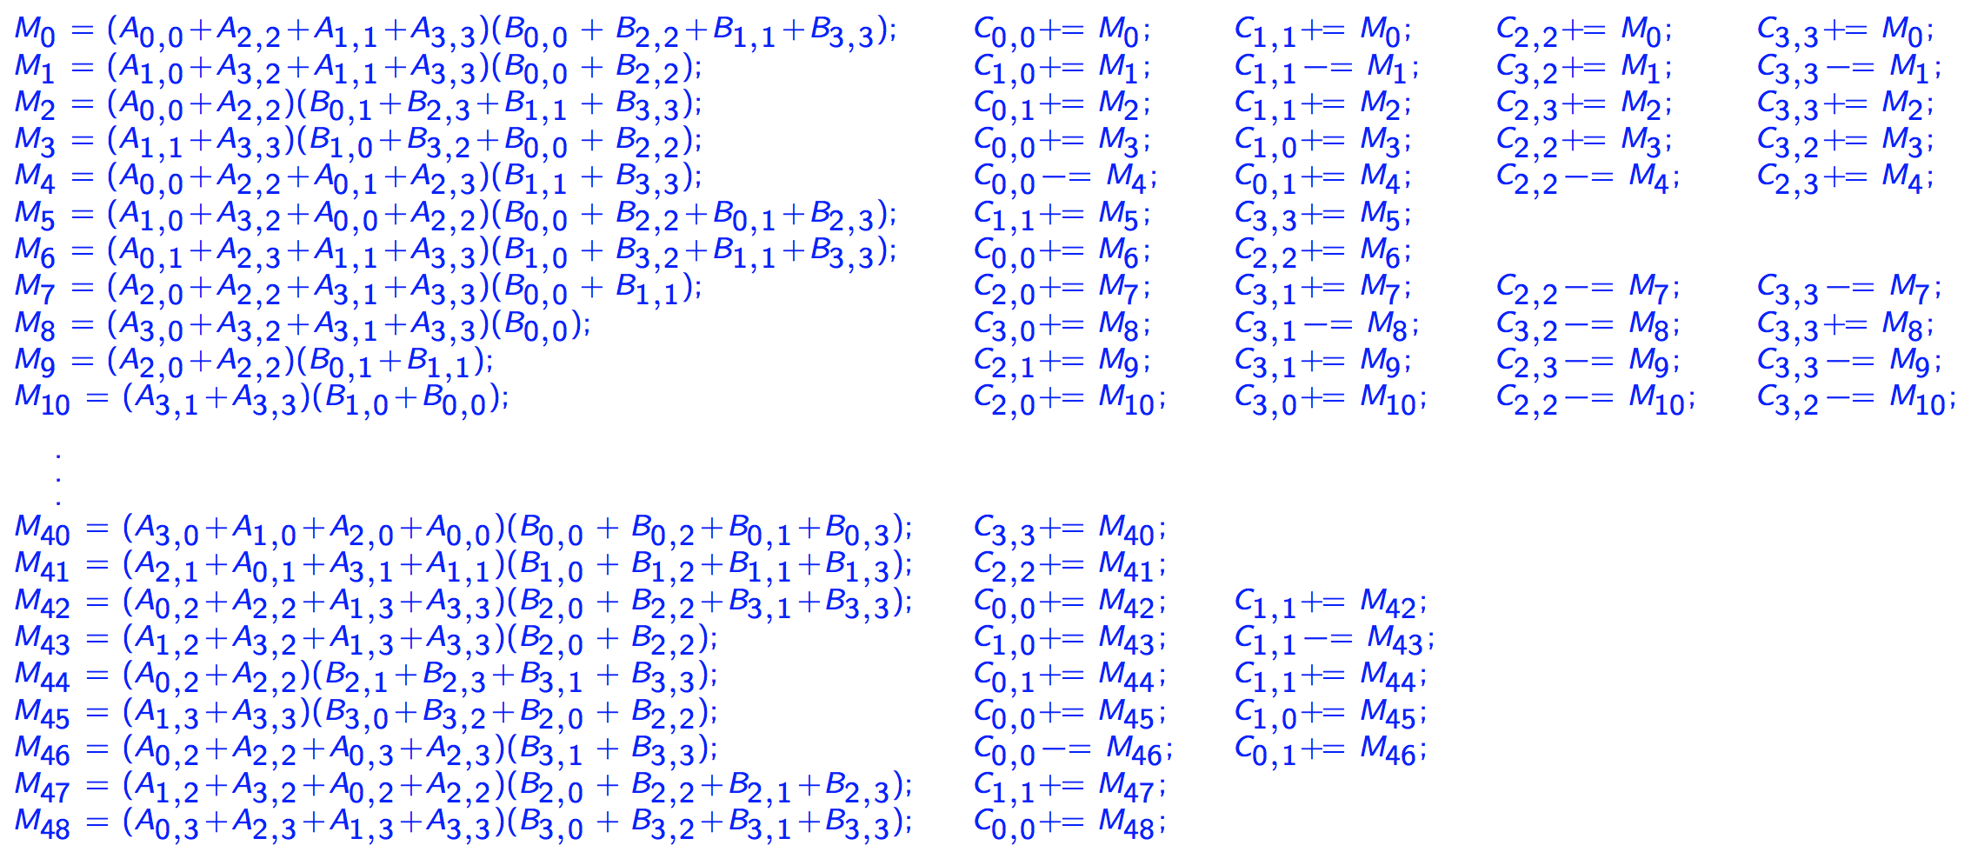
Arithmetic Operations
Submatrix
multiplication
Extra additions with submatrices of A, B, C, respectively
DGEMM
No extra additions
One-level Strassen (ABC, AB, Naïve)
7 submatrix multiplications
5 extra additions of submatrices of A and B
12 extra additions of submatrices of C
Two-level Strassen (ABC, AB, Naïve)
49 submatrix multiplications
95 extra additions of submatrices of A and B
144 extra additions of submatrices of C
M₀ := (A₀₀+A₁₁)(B₀₀+B₁₁); C₀₀ += M₀; C₁₁ += M₀;
M₁ := (A₁₀+A₁₁)B₀₀; C₁₀ += M₁; C₁₁ –= M₁;
M₂ := A₀₀(B₀₁–B₁₁); C₀₁ += M₂; C₁₁ += M₂;
M₃ := A₁₁(B₁₀–B₀₀); C₀₀ += M₃; C₁₀ += M₃;
M₄ := (A₀₀+A₀₁)B₁₁; C₀₁ += M₄; C₀₀ –= M₄;
M₅ := (A₁₀–A₀₀)(B₀₀+B₀₁); C₁₁ += M₅;
M₆ := (A₀₁–A₁₁)(B₁₀+B₁₁); C₀₀ += M₆;

Slide 33
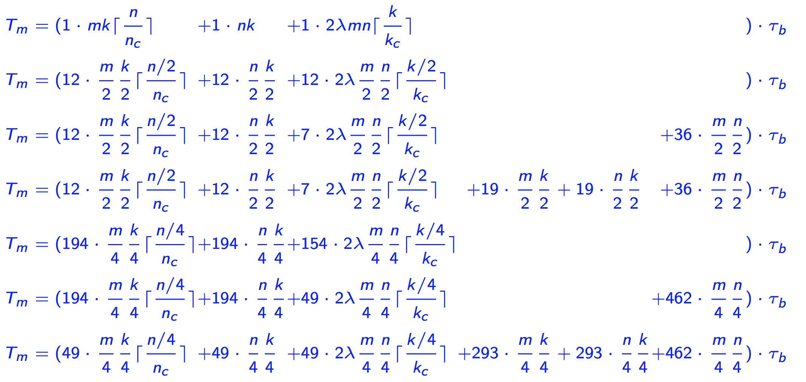
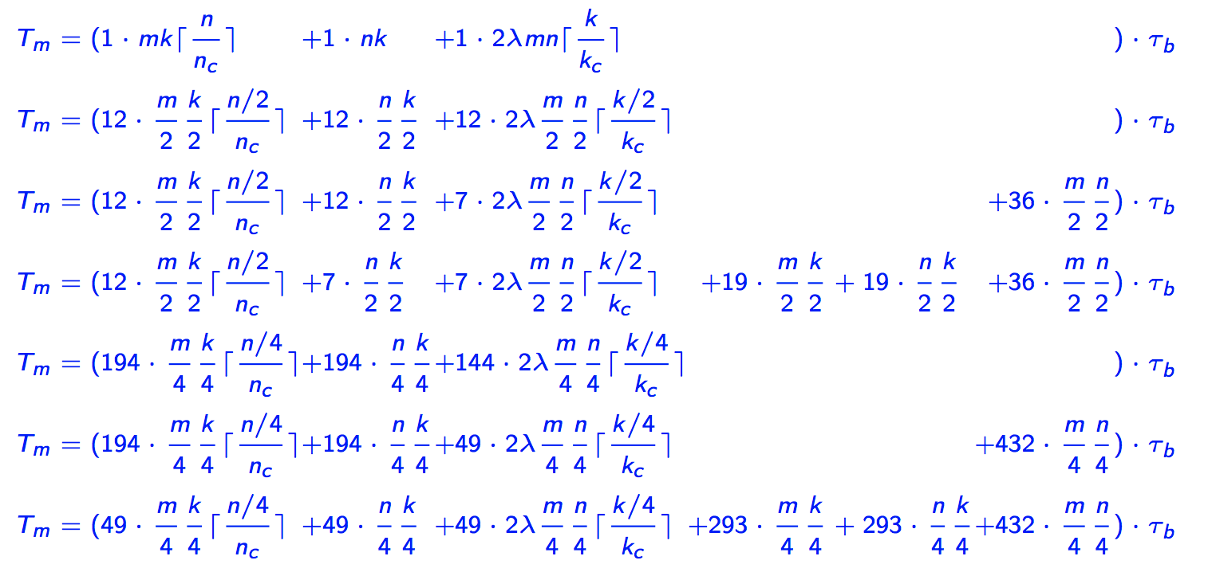
Memory Operations
DGEMM
One-level
ABC Strassen
AB Strassen
Naïve Strassen
Two-level
ABC Strassen
AB Strassen
Naïve Strassen

Slide 34
Modeled and Actual Performance on Single Core

Slide 35
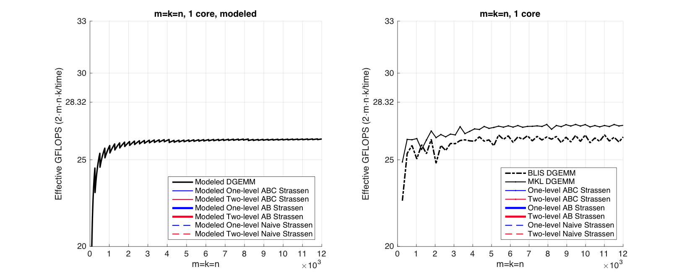
Observation (Square Matrices)
Modeled Performance
Actual Performance

Slide 36
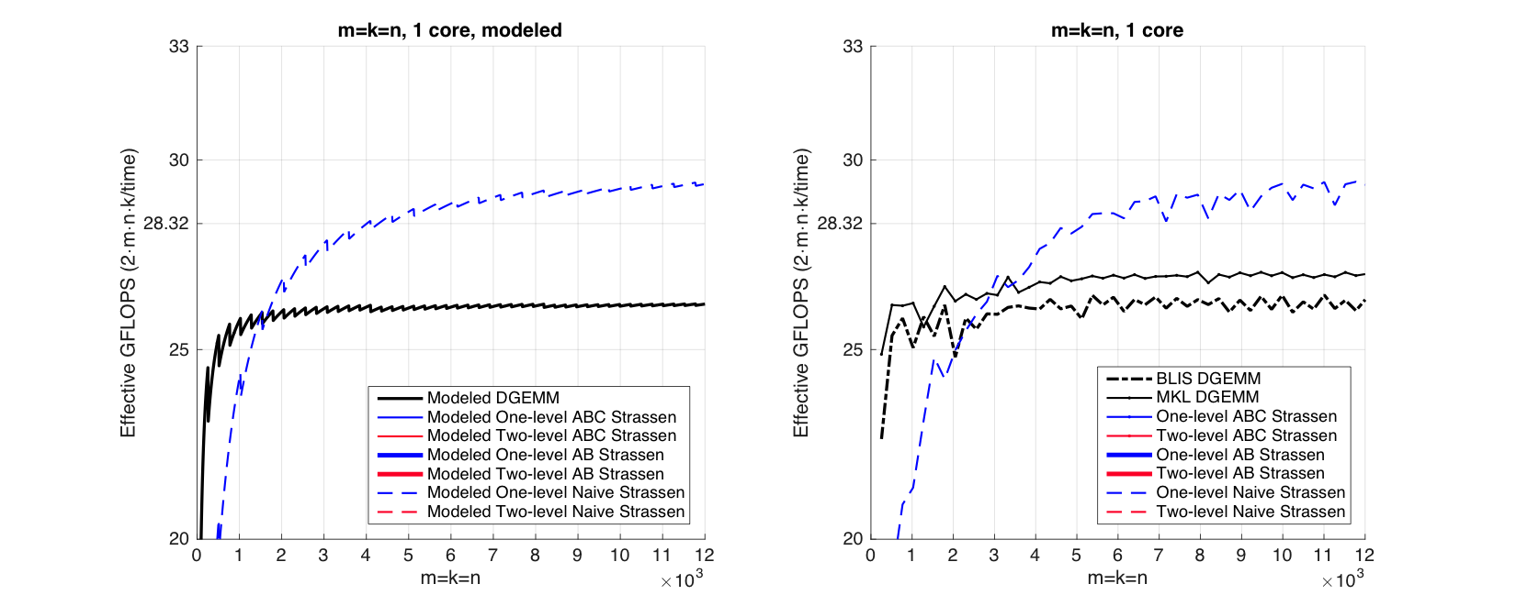
Observation (Square Matrices)
Modeled Performance
Actual Performance

Slide 37
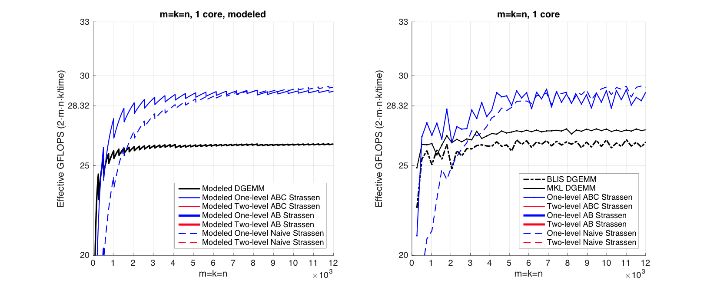
Observation (Square Matrices)
Modeled Performance
Actual Performance

Slide 38
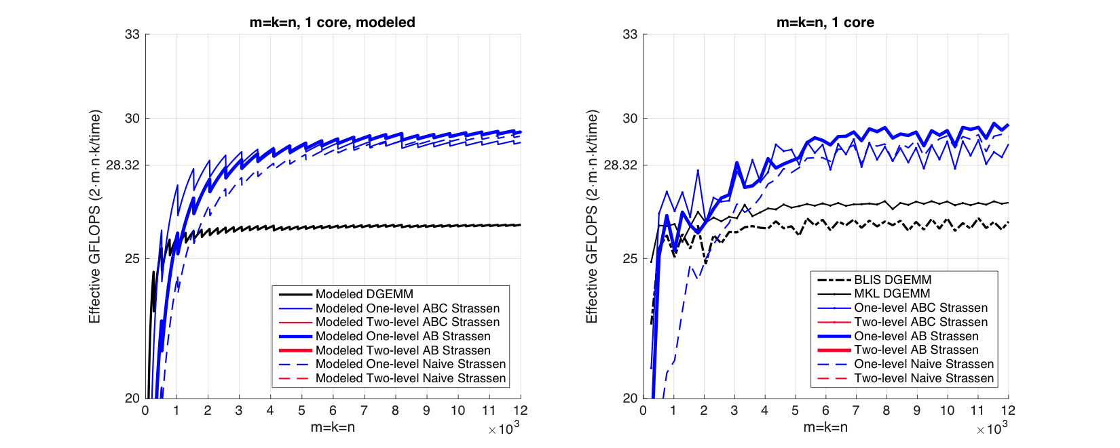
Observation (Square Matrices)
Modeled Performance
Actual Performance

Slide 39
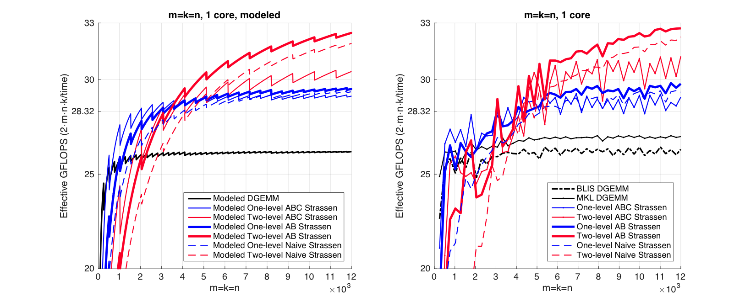
Observation (Square Matrices)
Modeled Performance
Actual Performance

Slide 40
Observation (Square Matrices)
Modeled Performance
Actual Performance
26.0%
13.1%
Theoretical Speedup over DGEMM
One-level Strassen (1+14.3% speedup)
8 multiplications → 7 multiplications;
Two-level Strassen (1+30.6% speedup)
64 multiplications → 49 multiplications;

Slide 41
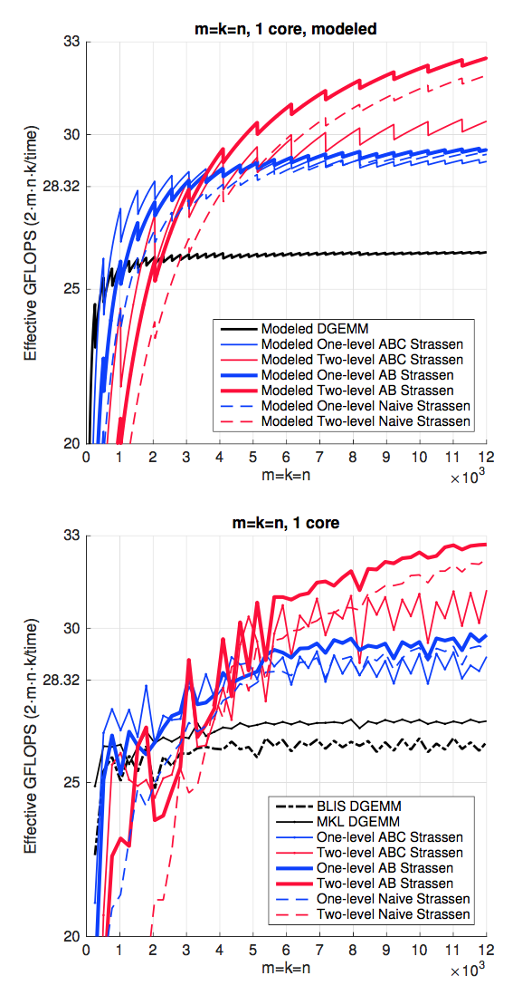


Observation (Square Matrices)
Both one-level and two-level
For small square matrices, ABC Strassen outperforms AB Strassen
For larger square matrices, this trend reverses
Reason
ABC Strassen avoids storing M (M resides in the register)
ABC Strassen increases the number of times for updating submatrices of C

Slide 42
M := (X+δY)(V+εW); C += γ₀M; D += γ₁M;
γ₀, γ₁,δ,ε ∈ {-1, 0, 1}.
C += AB;
M := (X+Y)(V+W); C += M; D += M;
k_{C} x n_{C}
L3 Cache
m_{C} x k_{C}
L2 Cache
m_{R} x n_{R}
Register

Slide 43
Observation (Square Matrices)
Both one-level and two-level
For small square matrices, ABC Strassen outperforms AB Strassen
For larger square matrices, this trend reverses
Reason
ABC Strassen avoids storing M (M resides in the register)
ABC Strassen increases the number of times for updating submatrices of C

Slide 44
Observation (Rank-k Update)
What is Rank-k update?
n
k
n
m
m

Slide 45
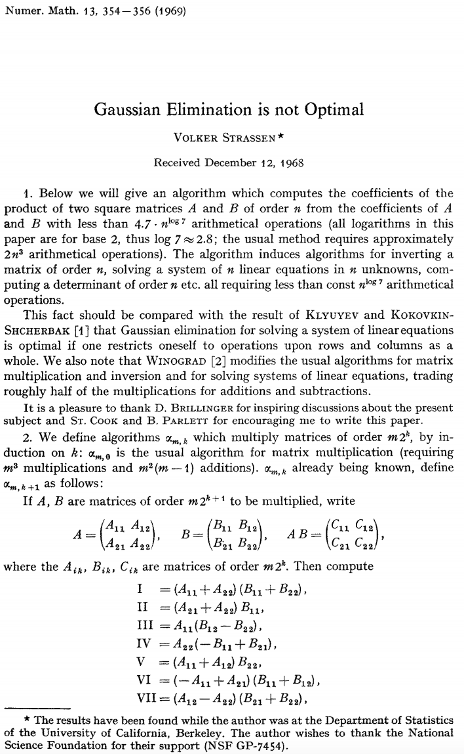
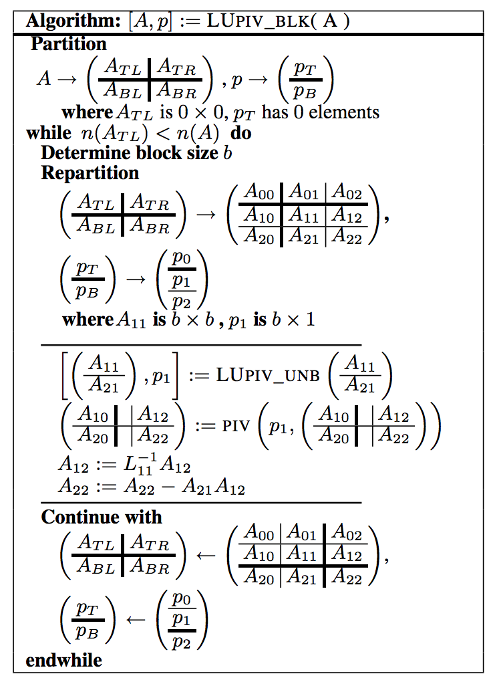
Observation (Rank-k Update)
Importance of Rank-k update
Blocked LU with partial pivoting (getrf)
A₁₂
A₂₁
A₂₂

Slide 46
Observation (Rank-k Update)
Importance of Rank-k update
A₁₂
+=
×
A₂₂
A₂₁

Slide 47
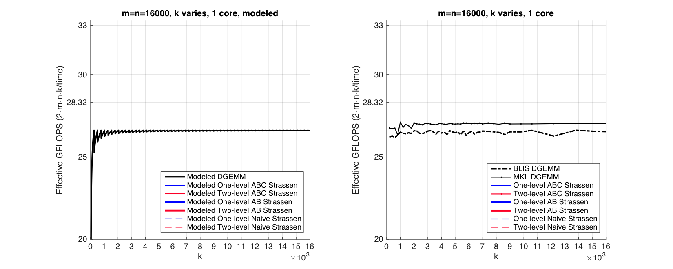
Observation (Rank-k Update)
Modeled Performance
Actual Performance

Slide 48
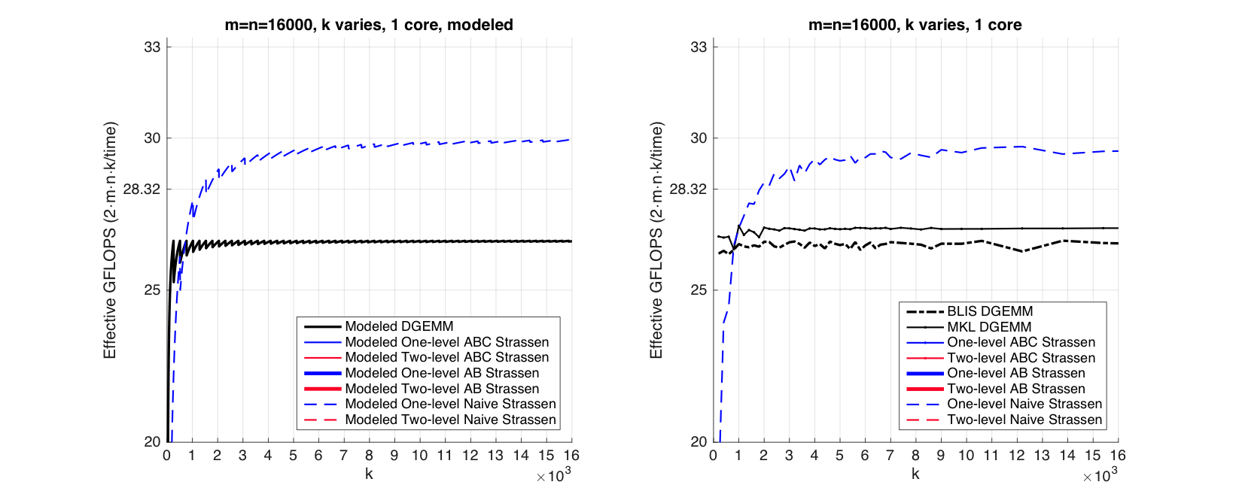
Observation (Rank-k Update)
Modeled Performance
Actual Performance

Slide 49
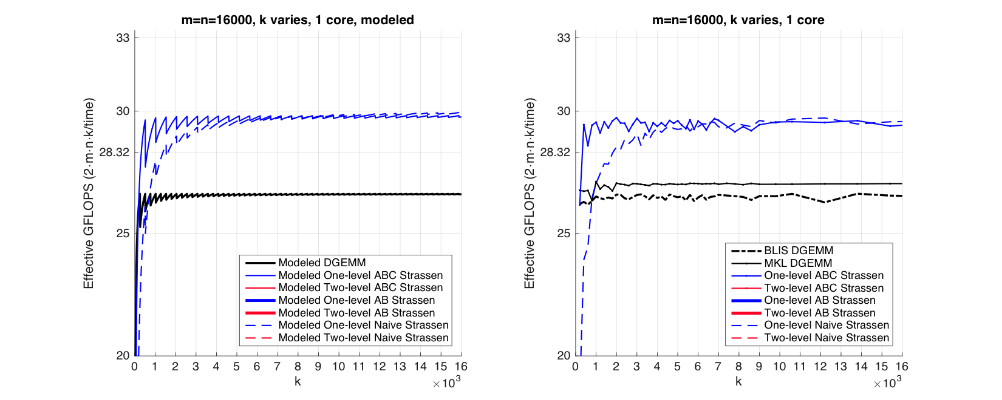
Observation (Rank-k Update)
Modeled Performance
Actual Performance

Slide 50
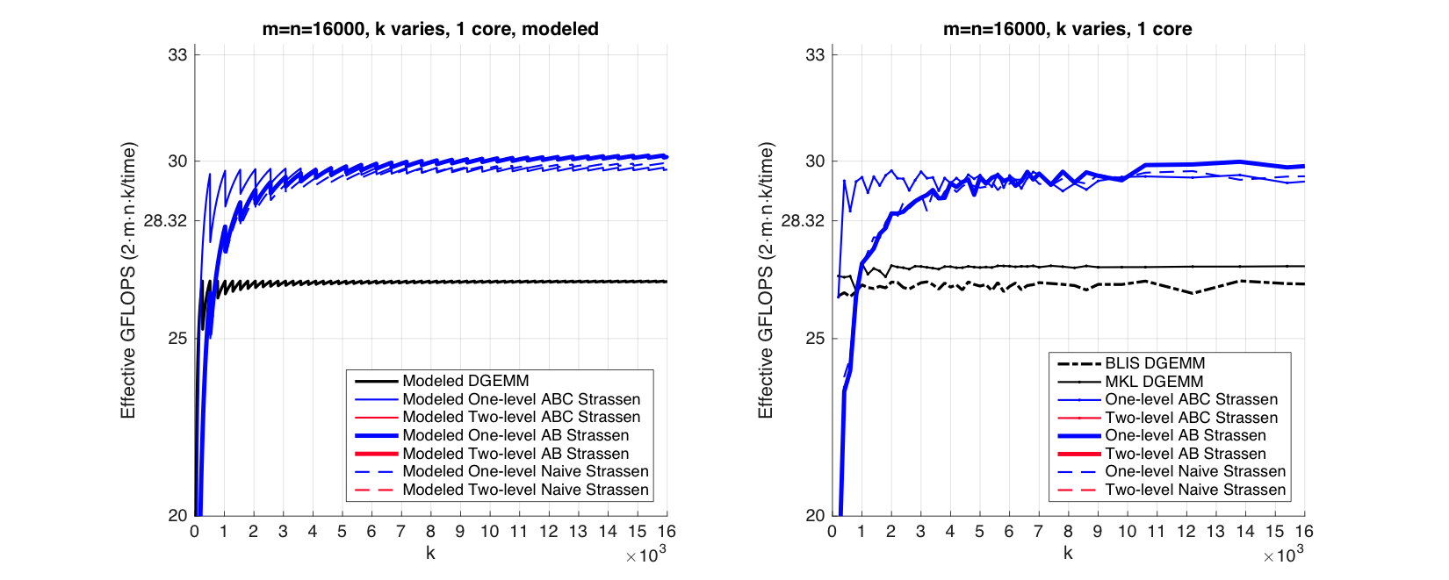
Observation (Rank-k Update)
Modeled Performance
Actual Performance

Slide 51
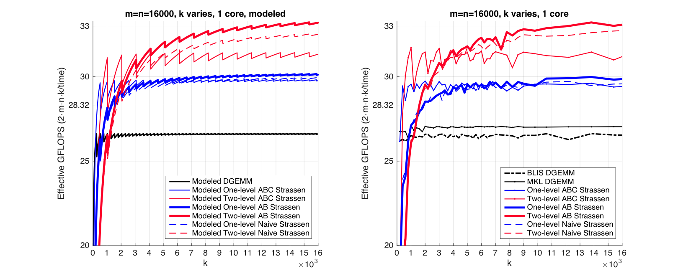
Observation (Rank-k Update)
Modeled Performance
Actual Performance

Slide 52
Observation (Rank-k Update)
Modeled Performance
Actual Performance
Reason:
ABC Strassen avoids forming the temporary matrix M explicitly in the memory (M resides in register), especially important when m, n >> k.

Slide 53
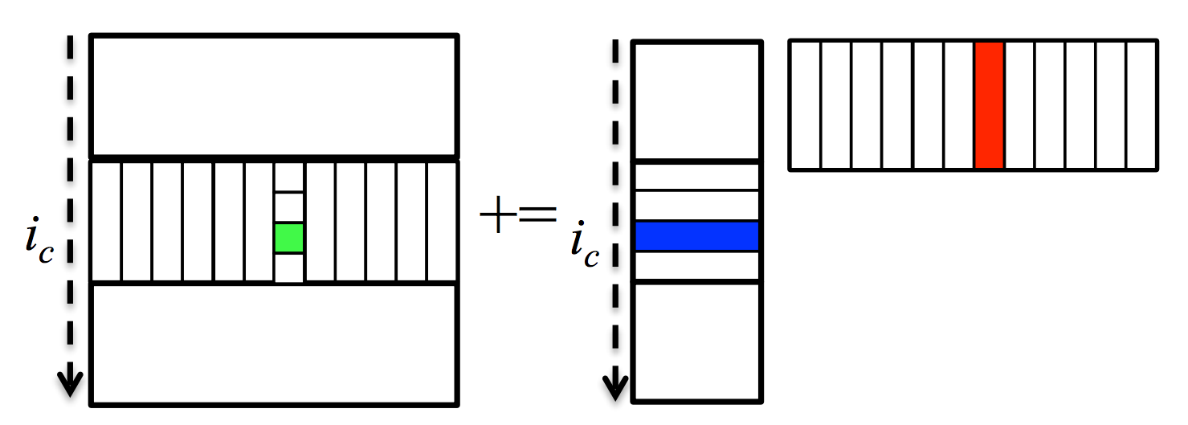
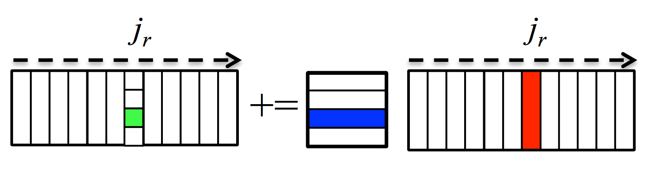
Parallelization
M := (X+Y)(V+W); C += M; D += M;
Use the same parallel scheme as BLIS: Parallelize 3rd or 2nd loop
Comparing with Task Parallelism:
Pro: data parallelism; load balance
Con: synchronization between instructions
*Tyler M. Smith, Robert Van De Geijn, Mikhail Smelyanskiy, Jeff R. Hammond, and Field G. Van Zee. "Anatomy of high-performance many-threaded matrix multiplication." In Parallel and Distributed Processing Symposium, 2014 IEEE 28th International, pp. 1049-1059. IEEE, 2014.

Slide 54

Intel Xeon E5-2680 v2 (Ivy Bridge, 10 core/socket)
1 core
5 core
10 core
Square Matrices
Rank-k Update

Slide 55
Outline
Motivation
Background
Practical Strassen’s Algorithm (SC16)
Practical Fast Matrix Multiplication (IPDPS17)
Proposed Work
Conclusion

Slide 56
Practical Fast Matrix Multiplication
*Jianyu Huang, Leslie Rice, Devin A. Matthews, Robert A. van de Geijn. “Generating Families of Practical Fast Matrix Multiplication Algorithms.” In IPDPS17

Slide 57

<2,2,2> Strassen’s Algorithm
M₀ := (A₀+A₃)(B₀+B₃); C₀ += M₀; C₃ += M₀;
M₁ := (A₂+A₃)B₀; C₂ += M₁; C₃ –= M₁;
M₂ := A₀(B₁–B₃); C₁ += M₂; C₃ += M₂;
M₃ := A₃(B₂–B₀); C₀ += M₃; C₂ += M₃;
M₄ := (A₀+A₁)B₃; C₁ += M₄; C₀ –= M₄;
M₅ := (A₂–A₀)(B₀+B₁); C₃ += M₅;
M₆ := (A₁–A₃)(B₂+B₃); C₀ += M₆;
Dario Bini, and Grazia Lotti. "Stability of fast algorithms for matrix multiplication." Numerische Mathematik 36.1 (1980): 63-72.

Slide 58

Fast Matrix Multiplication (FMM)
<2,2,2> Strassen’s Algorithm
M₀ := (A₀+A₃)(B₀+B₃); C₀ += M₀; C₃ += M₀;
M₁ := (A₂+A₃)B₀; C₂ += M₁; C₃ –= M₁;
M₂ := A₀(B₁–B₃); C₁ += M₂; C₃ += M₂;
M₃ := A₃(B₂–B₀); C₀ += M₃; C₂ += M₃;
M₄ := (A₀+A₁)B₃; C₁ += M₄; C₀ –= M₄;
M₅ := (A₂–A₀)(B₀+B₁); C₃ += M₅;
M₆ := (A₁–A₃)(B₂+B₃); C₀ += M₆;

Slide 59

Fast Matrix Multiplication (FMM)
M₀ := (A₀+A₃)(B₀+B₃); C₀ += M₀; C₃ += M₀;
M₁ := (A₂+A₃)B₀; C₂ += M₁; C₃ –= M₁;
M₂ := A₀(B₁–B₃); C₁ += M₂; C₃ += M₂;
M₃ := A₃(B₂–B₀); C₀ += M₃; C₂ += M₃;
M₄ := (A₀+A₁)B₃; C₁ += M₄; C₀ –= M₄;
M₅ := (A₂–A₀)(B₀+B₁); C₃ += M₅;
M₆ := (A₁–A₃)(B₂+B₃); C₀ += M₆;

Slide 60

Fast Matrix Multiplication (FMM)
M₀ := (A₀+A₃)(B₀+B₃); C₀ += M₀; C₃ += M₀;
M₁ := (A₂+A₃)B₀; C₂ += M₁; C₃ –= M₁;
M₂ := A₀(B₁–B₃); C₁ += M₂; C₃ += M₂;
M₃ := A₃(B₂–B₀); C₀ += M₃; C₂ += M₃;
M₄ := (A₀+A₁)B₃; C₁ += M₄; C₀ –= M₄;
M₅ := (A₂–A₀)(B₀+B₁); C₃ += M₅;
M₆ := (A₁–A₃)(B₂+B₃); C₀ += M₆;

Slide 61
Fast Matrix Multiplication (FMM)
M₀ := (A₀+A₃)(B₀+B₃); C₀ += M₀; C₃ += M₀;
M₁ := (A₂+A₃)B₀; C₂ += M₁; C₃ –= M₁;
M₂ := A₀(B₁–B₃); C₁ += M₂; C₃ += M₂;
M₃ := A₃(B₂–B₀); C₀ += M₃; C₂ += M₃;
M₄ := (A₀+A₁)B₃; C₁ += M₄; C₀ –= M₄;
M₅ := (A₂–A₀)(B₀+B₁); C₃ += M₅;
M₆ := (A₁–A₃)(B₂+B₃); C₀ += M₆;

Slide 62
Fast Matrix Multiplication (FMM)
<3,2,3> Fast Matrix Multiplication (FMM)
M₀ := (A₀+A₃)(B₀+B₃); C₀ += M₀; C₃ += M₀;
M₁ := (A₂+A₃)B₀; C₂ += M₁; C₃ –= M₁;
M₂ := A₀(B₁–B₃); C₁ += M₂; C₃ += M₂;
M₃ := A₃(B₂–B₀); C₀ += M₃; C₂ += M₃;
M₄ := (A₀+A₁)B₃; C₁ += M₄; C₀ –= M₄;
M₅ := (A₂–A₀)(B₀+B₁); C₃ += M₅;
M₆ := (A₁–A₃)(B₂+B₃); C₀ += M₆;

Slide 63
<3,2,3> Fast Matrix Multiplication (FMM)
M₀ := (–A₁+A₃+A₅)(B₄+B₅); C₂ –= M₀;
M₁ := (–A₀+A₂+A₅)(B₀–B₅); C₂ –= M₁; C₇ –= M₁;
M₂ := ( –A₀+A₂ )( –B₁–B₄ ); C₀–=M₂;C₁+=M₂;C₇+=M₂;
M₃ := ( A₂–A₄+A₅ )( B₂–B₃+B₅ ); C₂+=M₃;C₅+=M₃;C₆–=M₃;
M₄ := ( –A₀+A₁+A₂ )( B₀+B₁+B₄ ); C₀–=M₄;C₁+=M₄;C₄+=M₄;
M₅ := ( A₂ )( B₀ ); C₀+=M₅;C₁–=M₅;C₃+=M₅;C₄–=M₅;C₆+=M₅;
M₆ := ( –A₂+A₃+A₄–A₅ )( B₃–B₅ ); C₂–=M₆;C₅–=M₆;
M₇ := ( A₃ )( B₃ ); C₂+=M₇;C₃+=M₇;C₅+=M₇;
M₈ := ( –A₀+A₂+A₄ )( B₁+B₂ ); C₇+=M₈;
M₉ := ( –A₀+A₁ )( –B₀–B₁ ); C₁+=M₉;C₄+=M₉;
M₁₀ :=( A₅ )( B₂+B₅ ); C₂+=M₁₀;C₆+=M₁₀;C₈+=M₁₀;
M₁₁ := ( A₄–A₅ )( B₂ ); C₂+=M₁₁;C₅+=M₁₁;C₇–=M₁₁;C₈+=M₁₁;
M₁₂ := ( A₁ )( B₀+B₁+B₃+B₄ ); C₀+=M₁₂;
M₁₃ := ( A₂–A₄ )( B₀–B₂+B₃–B₅ ); C₆–=M₁₃;
M₁₄ := ( –A₀+A₁+A₂–A₃ )( B₅ ); C₂–=M₁₄;C₄–=M₁₄;

Slide 64

<3,2,3> Fast Matrix Multiplication (FMM)
M₀ := (–A₁+A₃+A₅)(B₄+B₅); C₂ –= M₀;
M₁ := (–A₀+A₂+A₅)(B₀–B₅); C₂ –= M₁; C₇ –= M₁;
M₂ := ( –A₀+A₂ )( –B₁–B₄ ); C₀–=M₂;C₁+=M₂;C₇+=M₂;
M₃ := ( A₂–A₄+A₅ )( B₂–B₃+B₅ ); C₂+=M₃;C₅+=M₃;C₆–=M₃;
M₄ := ( –A₀+A₁+A₂ )( B₀+B₁+B₄ ); C₀–=M₄;C₁+=M₄;C₄+=M₄;
M₅ := ( A₂ )( B₀ ); C₀+=M₅;C₁–=M₅;C₃+=M₅;C₄–=M₅;C₆+=M₅;
M₆ := ( –A₂+A₃+A₄–A₅ )( B₃–B₅ ); C₂–=M₆;C₅–=M₆;
M₇ := ( A₃ )( B₃ ); C₂+=M₇;C₃+=M₇;C₅+=M₇;
M₈ := ( –A₀+A₂+A₄ )( B₁+B₂ ); C₇+=M₈;
M₉ := ( –A₀+A₁ )( –B₀–B₁ ); C₁+=M₉;C₄+=M₉;
M₁₀ :=( A₅ )( B₂+B₅ ); C₂+=M₁₀;C₆+=M₁₀;C₈+=M₁₀;
M₁₁ := ( A₄–A₅ )( B₂ ); C₂+=M₁₁;C₅+=M₁₁;C₇–=M₁₁;C₈+=M₁₁;
M₁₂ := ( A₁ )( B₀+B₁+B₃+B₄ ); C₀+=M₁₂;
M₁₃ := ( A₂–A₄ )( B₀–B₂+B₃–B₅ ); C₆–=M₁₃;
M₁₄ := ( –A₀+A₁+A₂–A₃ )( B₅ ); C₂–=M₁₄;C₄–=M₁₄;

Slide 65


Slide 67
Speedup (%): FMM vs. GEMM

Slide 68
Speedup (%): FMM vs. GEMM
Practical #1: m=n=14400, k=480
* [1] Austin R. Benson, Grey Ballard. "A framework for practical parallel fast matrix multiplication." PPoPP15.

Slide 69
M := (X+δY)(V+εW); C += γ₀M; D += γ₁M;
γ₀, γ₁,δ,ε ∈ {-1, 0, 1}.
C += AB;
M := (X+Y)(V+W); C += M; D += M;
k_{C} x n_{C}
L3 Cache
m_{C} x k_{C}
L2 Cache
m_{R} x n_{R}
Register

Slide 70
Speedup (%): FMM vs. GEMM
Practical #1: m=n=14400, k=480
* [1] Austin R. Benson, Grey Ballard. "A framework for practical parallel fast matrix multiplication." PPoPP15.

Slide 71

Speedup (%): FMM vs. GEMM
Practical #1: m=n=14400, k=480
Practical #2: m=n=14400, k=12000
* [1] Austin R. Benson, Grey Ballard. "A framework for practical parallel fast matrix multiplication." PPoPP15.

Slide 72
Speedup (%): FMM vs. GEMM
Practical #1: m=n=14400, k=480
Practical #2: m=n=14400, k=12000
* [1] Austin R. Benson, Grey Ballard. "A framework for practical parallel fast matrix multiplication." PPoPP15.

Slide 73
One-level Fast Matrix Multiplication (FMM)
M₀ := (A₀+A₃)(B₀+B₃); C₀ += M₀; C₃ += M₀;
M₁ := (A₂+A₃)B₀; C₂ += M₁; C₃ –= M₁;
M₂ := A₀(B₁–B₃); C₁ += M₂; C₃ += M₂;
M₃ := A₃(B₂–B₀); C₀ += M₃; C₂ += M₃;
M₄ := (A₀+A₁)B₃; C₁ += M₄; C₀ –= M₄;
M₅ := (A₂–A₀)(B₀+B₁); C₃ += M₅;
M₆ := (A₁–A₃)(B₂+B₃); C₀ += M₆;

Slide 74






Two-level Fast Matrix Multiplication (FMM)
1st Level:
Partition:
Coefficient matrices:
2nd Level:
Partition:
Coefficient matrices:

Slide 75




Two-level Fast Matrix Multiplication (FMM)
Kronecker Product!
1-level Morton-like ordering index
2-level Morton-like ordering index
2-level Morton-like ordering index
1st Level:
Partition:
Coefficient matrices:
2nd Level:
Partition:
Coefficient matrices:

Slide 76



Two-level <2,2,2> Strassen Algorithm

Slide 77
Code Generator
FMM implementation Generator
Generate ~200 implementations
Model Generator
Generate the performance model for each implementation
Predict the relative performance accurately

Slide 78



Performance Model

Slide 79




Actual
Modeled
Actual
Modeled

Slide 80
Outline
Motivation
Background
Practical Strassen’s Algorithm (SC16)
Practical Fast Matrix Multiplication (IPDPS17)
Proposed Work
Conclusion

Slide 81
1. Tensor Contraction
Jianyu Huang, Devin A. Matthews, and Robert A. van de Geijn. “Strassen’s Algorithm for Tensor Contraction.” arXiv:1704.03092 (2017). In Submission.

Slide 82








Matrix vs. Tensor
Matrix Multiplication
Tensor Contraction
BLAS/BLIS!
TBLIS!
Devin A. Matthews. “High-Performance Tensor Contraction without Transposition.” Accepted in SISC.

Slide 83

Matrix vs. Tensor
Matrix Multiplication
Tensor Contraction
BLAS/BLIS!
TBLIS!
Devin A. Matthews. “High-Performance Tensor Contraction without Transposition.” Accepted in SISC.

Slide 84


Performance for Tensor Strassen
is denoted as
Jianyu Huang, Devin A. Matthews, and Robert A. van de Geijn. “Strassen’s Algorithm for Tensor Contraction.” arXiv:1704.03092 (2017). In Submission.

Slide 85
2. Other extensions

Slide 86


Distributed Memory:
Run Strassen on the inter-processor level:
utilize larger submatrix size
Reduce the communication overhead:
fuse packing with collective communications
Machine Learning Primitives:
GraphBLAS primitive operation:
Generaralized GEMM-like ML operation:

Slide 87
Outline
Motivation
Background
Practical Strassen’s Algorithm (SC16)
Practical Fast Matrix Multiplication (IPDPS17)
Proposed Work
Conclusion

Slide 88
To achieve practical high performance
of Strassen/FMM algorithms…...
Conventional Implementations
Our Solutions
Matrix Size
Must be large
Matrix Shape
Must be square
Memory movement
No Additional
Workspace
Padding
Buffers
Parallelism
Usually task parallelism
Can be data parallelism

Slide 89
Proposed Work
Practical high-performance Strassen.
Utilize a performance model to predict the relative performance
Practical fast matrix multiplication algorithms.
Leverage a code generator to generate ~200 implmentations
Acceleration of tensor contractions via Strassen.
First paper to apply Strassen’s algorithm for tensor contraction.
Exploration of Strassen/FMM for distributed memory.
Fusion with machine learning applications.
Pedagogical outreach for Strassen.
Jianyu Huang, Tyler Smith, Greg Henry, and Robert van de Geijn. “Strassen’s Algorithm Reloaded.” In SC’16.
Jianyu Huang, Leslie Rice, Devin A. Matthews, Robert A. van de Geijn. “Generating Families of Practical Fast Matrix Multiplication Algorithms.” In IPDPS17
Jianyu Huang, Devin A. Matthews, and Robert A. van de Geijn. “Strassen’s Algorithm for Tensor Contraction.” arXiv:1704.03092 (2017). In Submission.
Jianyu Huang, Robert A. van de Geijn. “BLISlab: A Sandbox for Optimizing GEMM.” FLAME Working Note #80, The University of Texas at Austin, Department of Computer Science. Technical Report TR-16-13. August 31, 2016.

Slide 90
Publications
Papers
Jianyu Huang, Devin A. Matthews, and Robert A. van de Geijn. “Strassen’s Algorithm for Tensor Contraction.” arXiv:1704.03092 (2017). In Submission.
Jianyu Huang, Leslie Rice, Devin A. Matthews, Robert A. van de Geijn. “Generating Families of Practical Fast Matrix Multiplication Algorithms.” In IPDPS17
Jianyu Huang, Tyler M. Smith, Greg H. Henry, and Robert A. van de Geijn. “Strassen’s Algorithm Reloaded.” In SC’16.
Chenhan D. Yu, Jianyu Huang, Woody Austin, Bo Xiao, George Biros. “Performance Optimization for the K-Nearest Neighbors Kernel on x86 Architectures.” In SC’15
Software
Code Generator for Practical Fast Matrix Multiplication Algorithms:
https://github.com/flame/fmm-gen
Strassen’s Algorithm for Tensor Contraction:
https://github.com/flame/tblis-strassen
Pedagogical Effort
Jianyu Huang, Robert A. van de Geijn. “BLISlab: A Sandbox for Optimizing GEMM.” FLAME Working Note #80, The University of Texas at Austin, Department of Computer Science. Technical Report TR-16-13. August 31, 2016.
https://github.com/flame/blislab

Slide 91
Thank you!

Slide 92
















Acknowledgement

